Slide 1
(Deep) Reinforcement Learning Overview:
Basic Assumptions, Why Deep-, SOTAs,
Trends and Personal Ideas
Reinforcement learning uses the formal framework of Markov decision processes to define the interaction between a learning agent and its environment in terms of states, actions, and rewards. This framework is intended to be a simple way of representing essential features of the artificial intelligence problem.
Richard S. Sutton and Andrew G. Barto
刘洪佳
PiperLiu@qq.com

Slide 2
Outline
Basic Assumptions
Markov Decision Processes
Dynamic Programming
Policy Improvement
Why Deep-
Distribution to Distribution
Generalization
SOTAs
Policy-based: TRPO -> ACKTR -> PPO
Value-based: DDPG -> TD3 -> SAC
Combination of the Two: A2C…
Trends
Imitation Learning, IRL (with GAN, GAIL)
Model-based, Multi-Agent…
Personal Ideas
Good Resources I Found
What about traffic with RL?

Slide 3
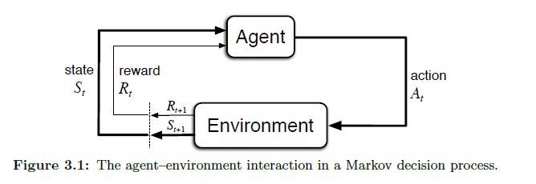
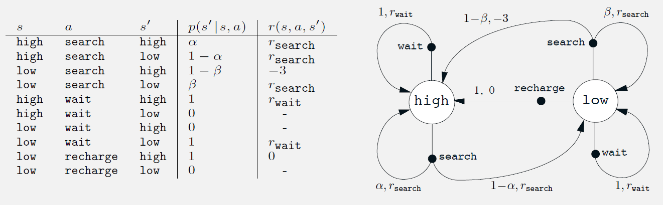
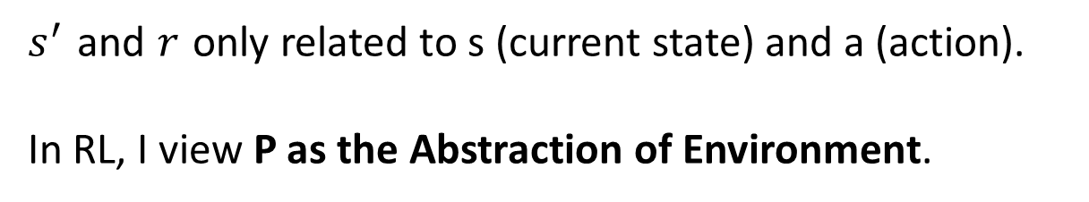
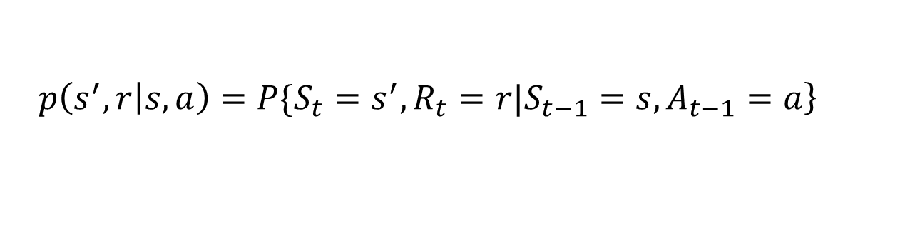
Basic Assumptions : Markov Decision Processes
$$\left.p\left(s^{′},r | s,a\right)=P\{S_{t}=s^{′},R_{t}=r|S_{t−1}=s,A_{t−1}=a\right\}$$
$s^{′}$ and $r$ only related to s (current state) and a (action).
In RL, I view P as the Abstraction of Environment.

Slide 4
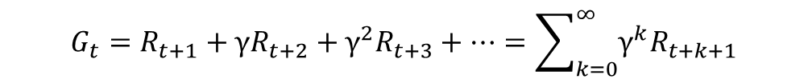
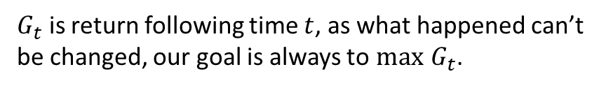
Basic Assumptions : Dynamic Programming
$G_{t}$ is return following time $t$, as what happened can’t be changed, our goal is always to $max$ $G_{t}$.
$$G_{t}=R_{t+1}+γR_{t+2}+γ^{2}R_{t+3}+…=\sum_{k=0}^{∞}{γ^{k}R_{t+k+1}}$$
So what is the independent variable to optimize? $π$
$$π\left(a | s\right)\sim some distribution$$
It's very understandable that we define $v_{π}\left(s\right)$
And $q_{π}\left(s,a\right)$
PiperLiu’s CSDN Blog:
https://blog.csdn.net/weixin_42815609/article/details/103934891

Slide 5
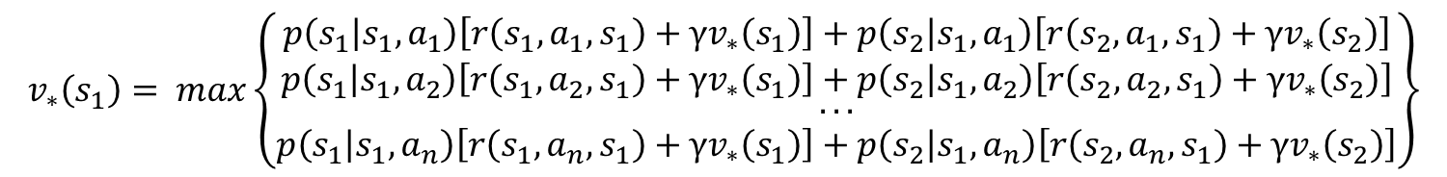
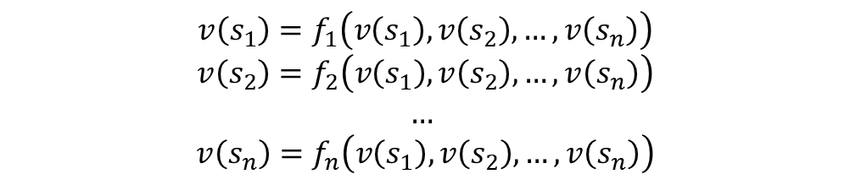
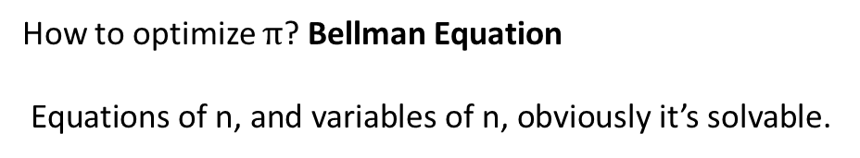
Basic Assumptions : Dynamic Programming
How to optimize $π$? Bellman Equation
Equations of n, and variables of n, obviously it’s solvable.
$$v\left(s_{1}\right)=f_{1}\left(v\left(s_{1}\right),v\left(s_{2}\right),…,v\left(s_{n}\right)\right)$$
$$v\left(s_{2}\right)=f_{2}\left(v\left(s_{1}\right),v\left(s_{2}\right),…,v\left(s_{n}\right)\right)$$
$$…$$
$$v\left(s_{n}\right)=f_{n}\left(v\left(s_{1}\right),v\left(s_{2}\right),…,v\left(s_{n}\right)\right)$$
Assume there are only two states, the equations of $v\left(s_{1}\right)$ is
$$v_{∗}\left(s_{1}\right)= max\left\{\begin{matrix}\begin{matrix}p\left(s_{1} | s_{1},a_{1}\right)\left[r\left(s_{1},a_{1},s_{1}\right)+γv_{∗}\left(s_{1}\right)\right]+p\left(s_{2} | s_{1},a_{1}\right)\left[r\left(s_{2},a_{1},s_{1}\right)+γv_{∗}\left(s_{2}\right)\right] \\ p\left(s_{1} | s_{1},a_{2}\right)\left[r\left(s_{1},a_{2},s_{1}\right)+γv_{∗}\left(s_{1}\right)\right]+p\left(s_{2} | s_{1},a_{2}\right)\left[r\left(s_{2},a_{2},s_{1}\right)+γv_{∗}\left(s_{2}\right)\right]\end{matrix} \\ \begin{matrix}... \\ p\left(s_{1} | s_{1},a_{n}\right)\left[r\left(s_{1},a_{n},s_{1}\right)+γv_{∗}\left(s_{1}\right)\right]+p\left(s_{2} | s_{1},a_{n}\right)\left[r\left(s_{2},a_{n},s_{1}\right)+γv_{∗}\left(s_{2}\right)\right]\end{matrix}\end{matrix}\right\}$$
Obviously, solving equations to optimize is difficult… Use Iteration!
PiperLiu’s CSDN Blog:
https://blog.csdn.net/weixin_42815609/article/details/103934891

Slide 6
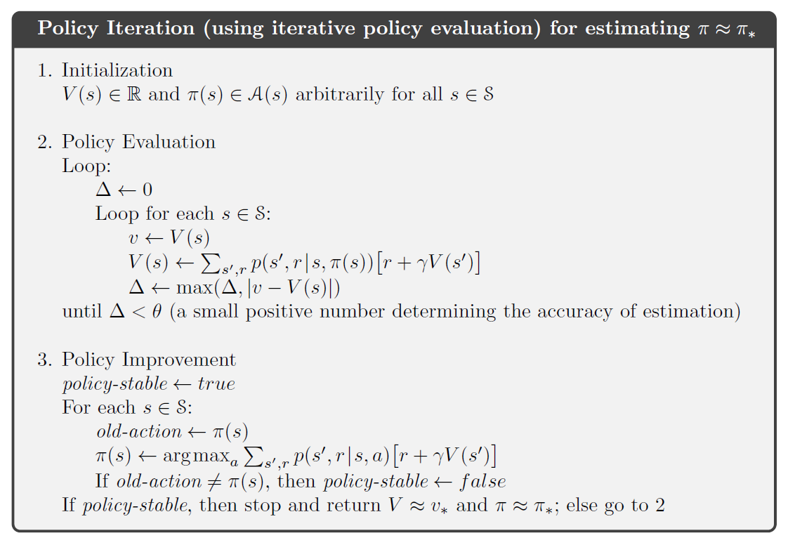
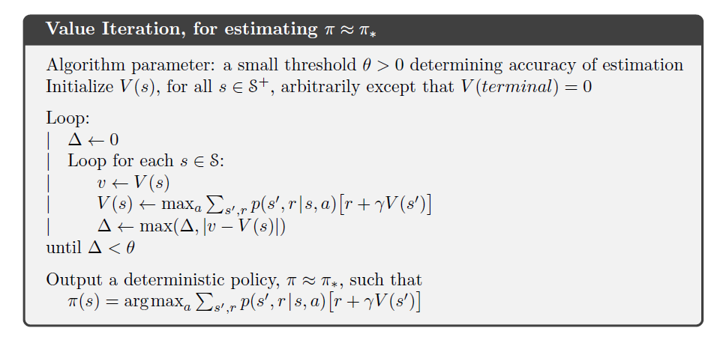
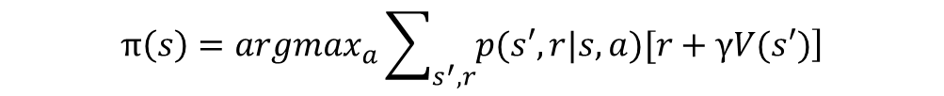
Basic Assumptions : Policy Improvement
There are mainly two ways to optimize with iteration.
Policy Iteration: Use Policy Evaluation to estimate the value of each s under this policy, then use Policy Improvement update policy.
Value Iteration: When estimating the value of each s, update value. The policy is
$$π\left(s\right)=argmax_{a}\sum_{s^{′},r}{\left.p(s′,r|s,a)[r+γV(s′)\right]}$$
Use absurdity to prove: this is a effective way to solve Bellman Equation.
PiperLiu’s CSDN Blog:
https://blog.csdn.net/weixin_42815609/article/details/103998602

Slide 7
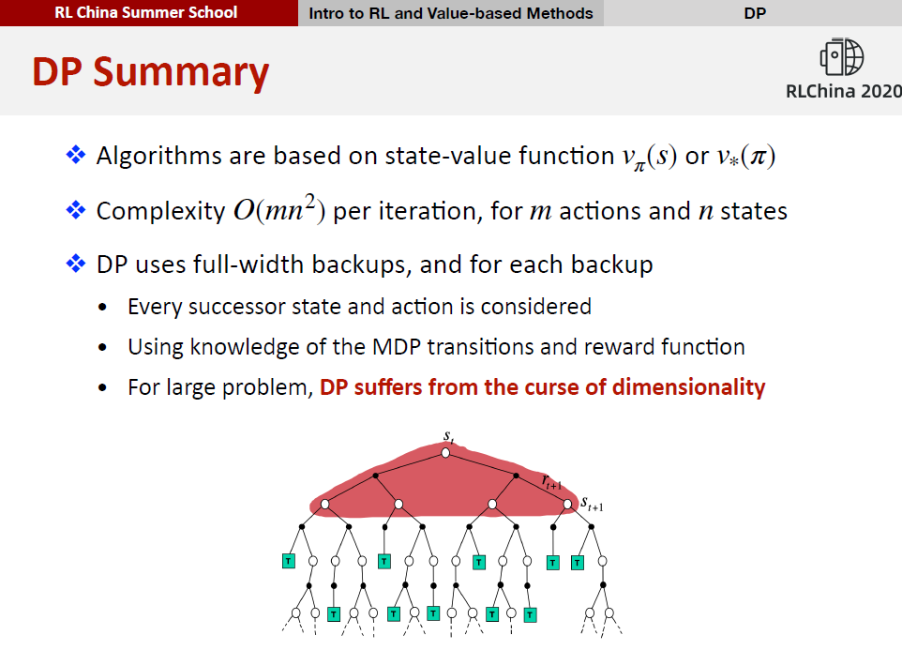
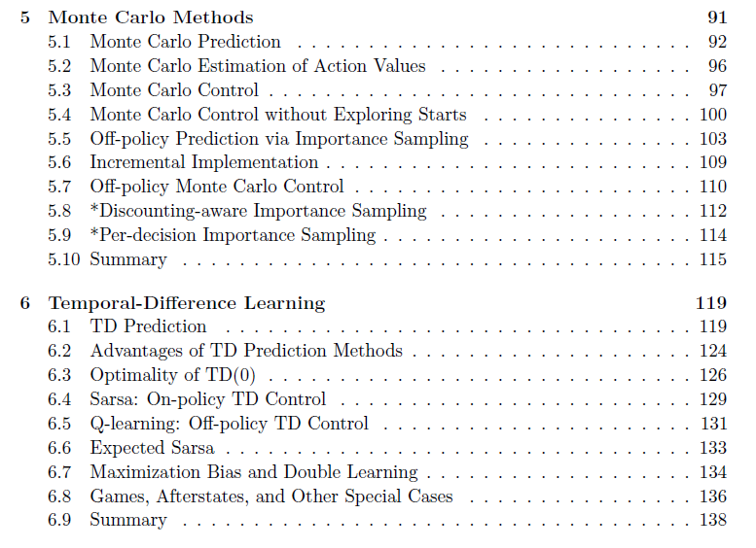
Basic Assumptions : But… we don’t know the env…usually
Main Frame of Reinforcement Learning is led out:

Slide 8
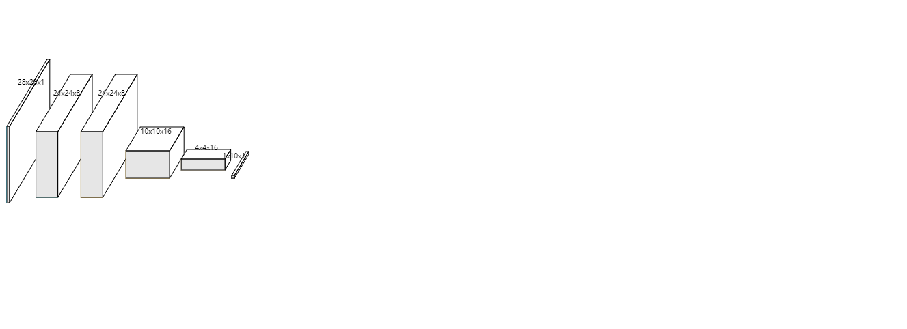
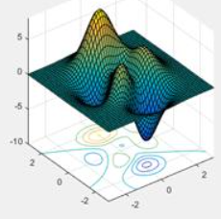
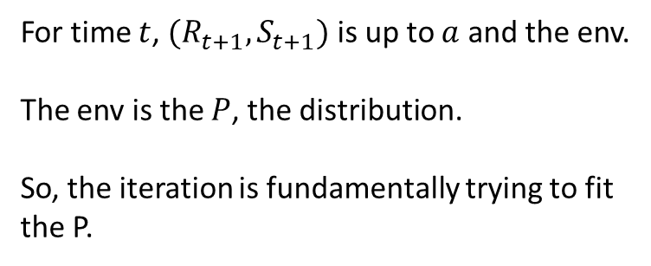
Why Deep- : Distribution to Distribution
Whatever the method of RL is, we are always ‘Building a Map of Distribution to Distribution’.
Q-learning as example:
$$Q\left(S_{t},A_{t}\right)←Q\left(S_{t},A_{t}\right)+α\left[R_{t+1}+γ\max_{a}{Q}\left(S_{t+1},a\right)−Q\left(S_{t},A_{t}\right)\right]$$
For time $t$, $(R_{t+1},S_{t+1})$ is up to $a$ and the env.
The env is the $P$, the distribution.
So, the iteration is fundamentally trying to fit the P.
Input data:
The Interaction data of agent and env. However, how the agent acts, is determined by Q, and Q is trying to fit env, when inits.
Output:
Q function, how to act in current state.
It’s a distribution.
NNs was born to solve the problem of Distribution mapped to Distribution.
NNs is the Q function
I can’t assure my idea is correct, any question email piperliu@qq.com.

Slide 9

Why Deep- : Generalization
Between traditional Tabular RL and Deep-RL…
S | a | Q
(1,2,3) | 1 | 20.0
(1,2,4) | 1 | 19.4
(1,2,5) | 1 | 19.2
(1,2,6) | 1 | -2.4
… | … | …
(1,2,3) | 5 | 3.0
(1,2,4) | 5 | 3.4
(1,2,5) | 5 | 3.2
(1,2,6) | 5 | -10.2
The technology of Deep Learning is so amazing, that the NNs can found the mapping between raw states and actions.
The Nature published the DQN Human-level control through deep reinforcement learning in 2015.
NNs is the Q function: input s and output Q’s distribution
Choose the best a for max Q to act.
Traditional Tabular RL: not fit for practical problem

Slide 10
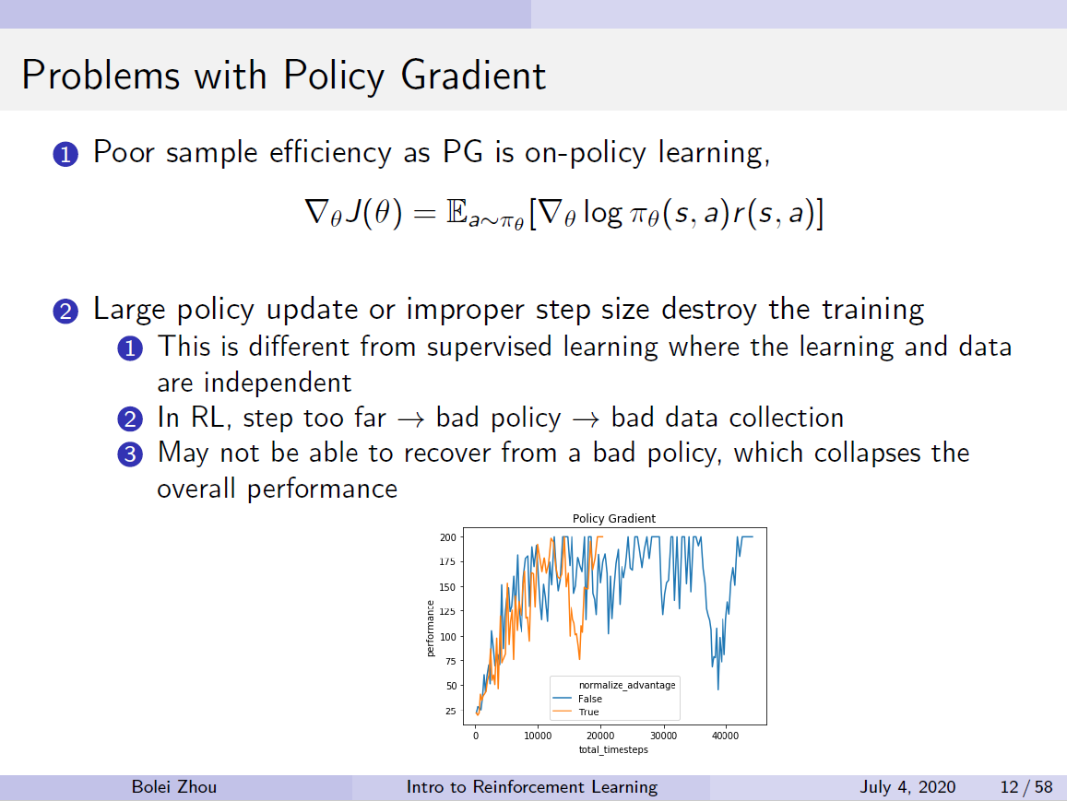
SOTAs : Policy-based, TRPO -> ACKTR -> PPO
TRPO for solving two problems in traditional PG:
PG is on-policy, which means low efficiency;
Bad sampling may make the agent update to be worse.
So what does TRPO do:
Trust Region and Natural Policy Gradient to make the training more stable;
Using Importance Sampling to make it as off-policy optimization.

Slide 11
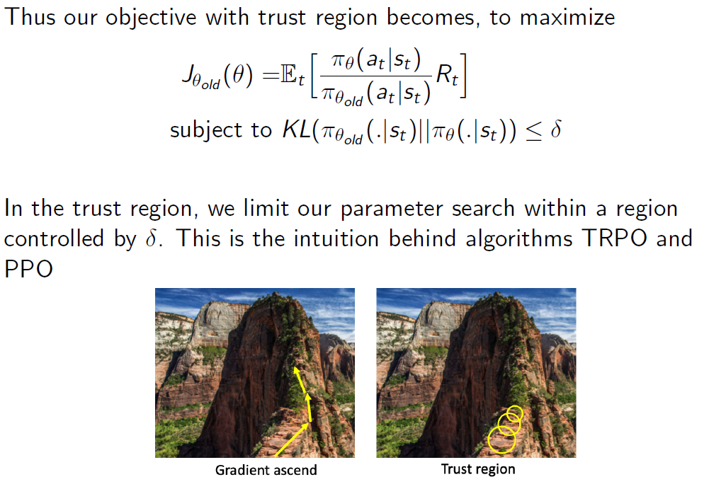
SOTAs : Policy-based, TRPO -> ACKTR -> PPO
As you see, we do not want the KL divergence between old policy and policy to be too large. We put a constraint.
Besides, we use a importance sampling in E.
To implement it in iteration, there a lots of foundation work and derivation in the paper, like, Fisher Information Matrix’s estimation etc.
But TRPO is too expensive for computing. Let’s see ACKTR.

Slide 12
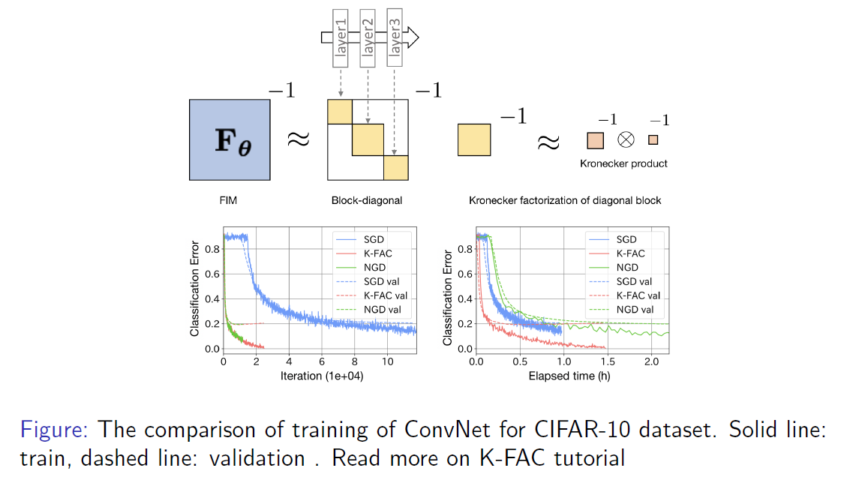
SOTAs : Policy-based, TRPO -> ACKTR -> PPO
ACKTR: Calculating Natural Gradient with KFAC.
I view it as a new method of optimization of parameters for TRPO.
Since TRPO calculates the inverse of the Fisher Information Matrix (FIM), ACKTR uses
the Kronecker-factored approximation curvature (K-FAC) to make it better and faster.

Slide 13
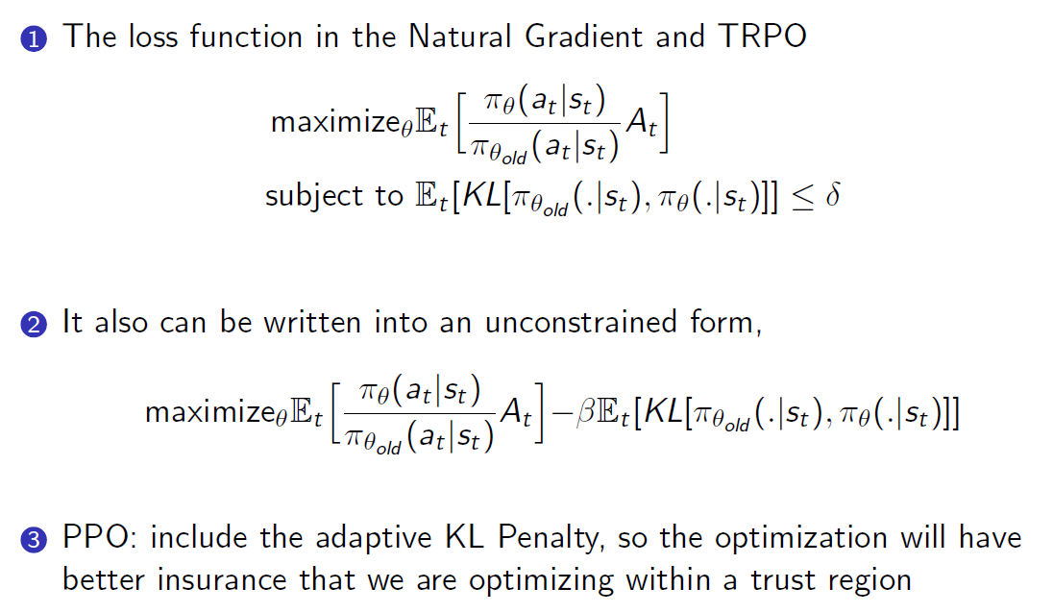
SOTAs : Policy-based, TRPO -> ACKTR -> PPO
PPO: Proximal Policy Optimization.
The SOTA of OpenAI. OpenAI view it as a baseline of RL method.
Similar to all DL, there is more focusing on the effect of engineering, some tricks are very efficiency but may not be totally discussed in theory.
Trick like PPO with clipping is very popular.

Slide 14
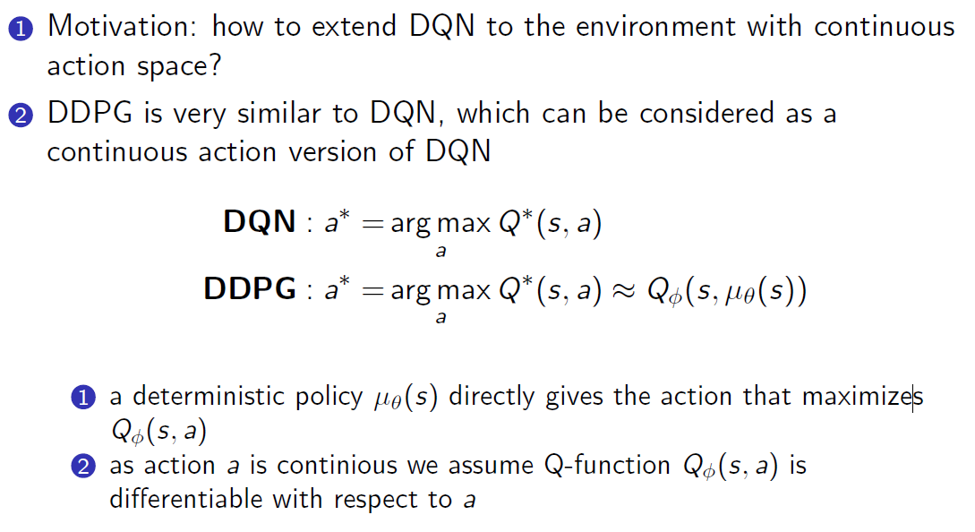
SOTAs : Value-based: DDPG -> TD3 -> SAC
DDPG: Deep Deterministic Policy Gradient
Though named ‘Policy Gradient’, but inherits DQN.
From the view of result, it can be seen as DQN with ‘continuous’ action. But in math, they are different.

Slide 15
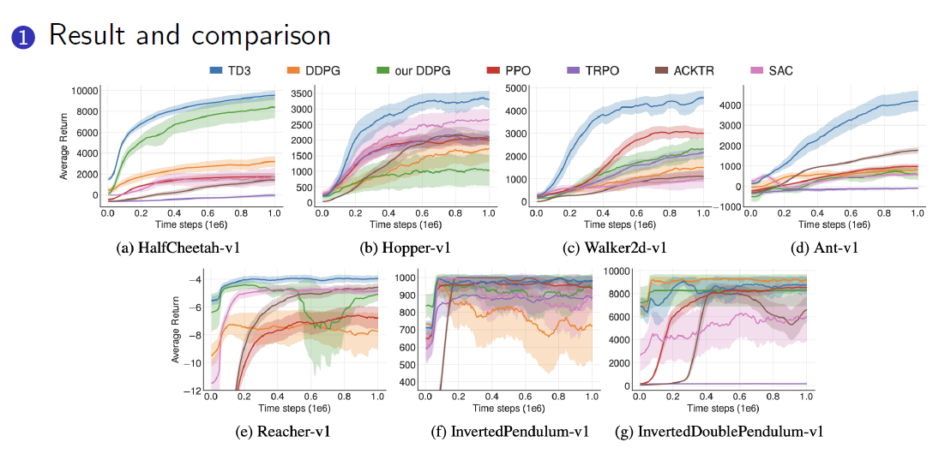
SOTAs : Value-based: DDPG -> TD3 -> SAC
TD3: Twin Delayed DDPG
More tricks on DDPG, as DDPG learned Q-function sometimes dramatically overestimate Q-values.
SAC: Soft Actor-Critic

Slide 16
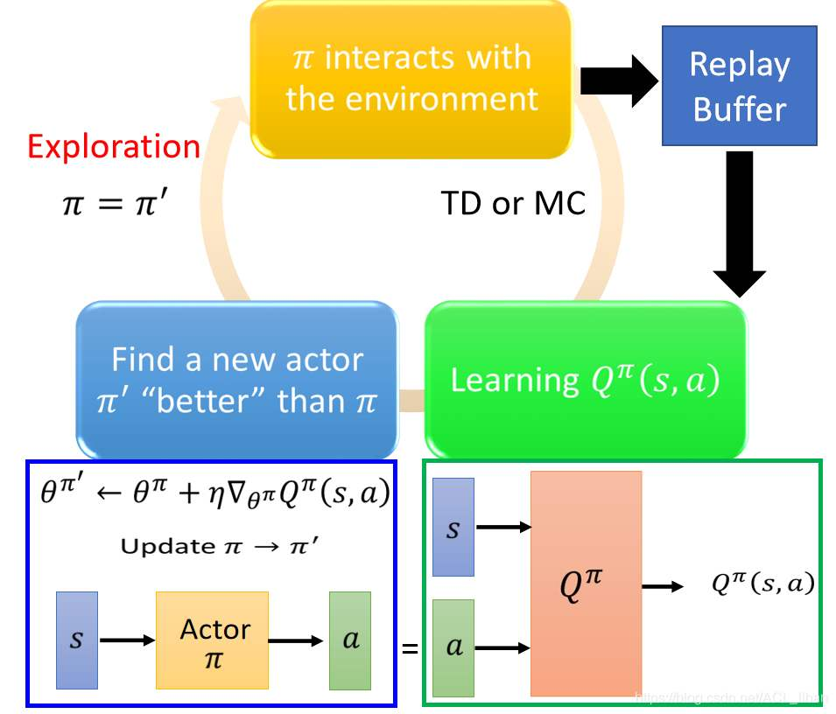
Combination of the Two: A2C…
Let’s see code.
link
There is no the best Algorithm.
When solving problem, don’t give up to try ideas.

Slide 17
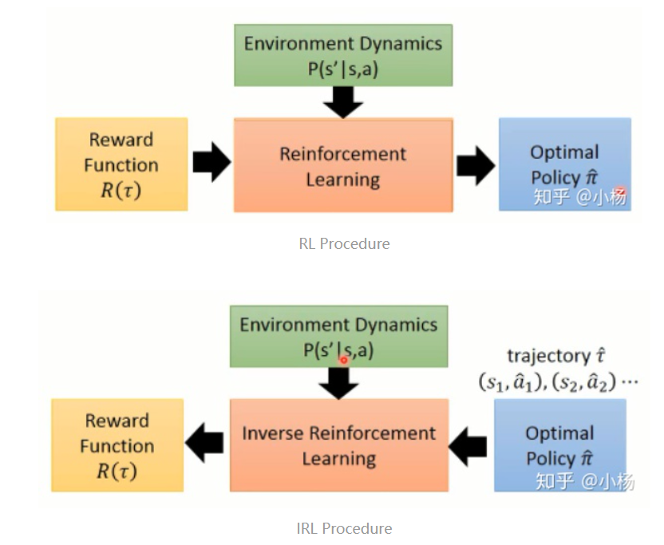
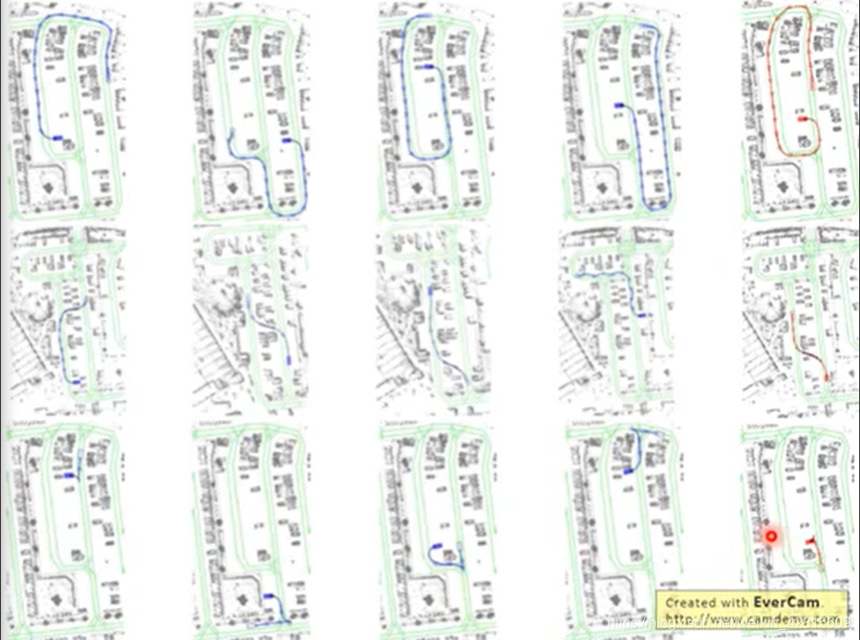
Trends : Imitation Learning, IRL (with GAN, GAIL)
Inverse Reinforcement Learning.
Automatic Control, Abnormal Detection…

Slide 18
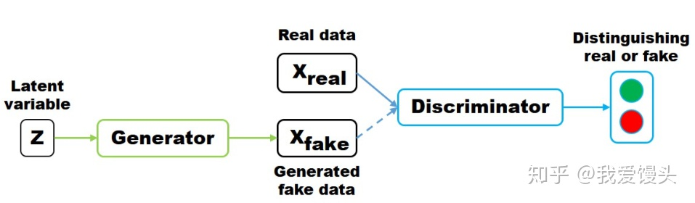
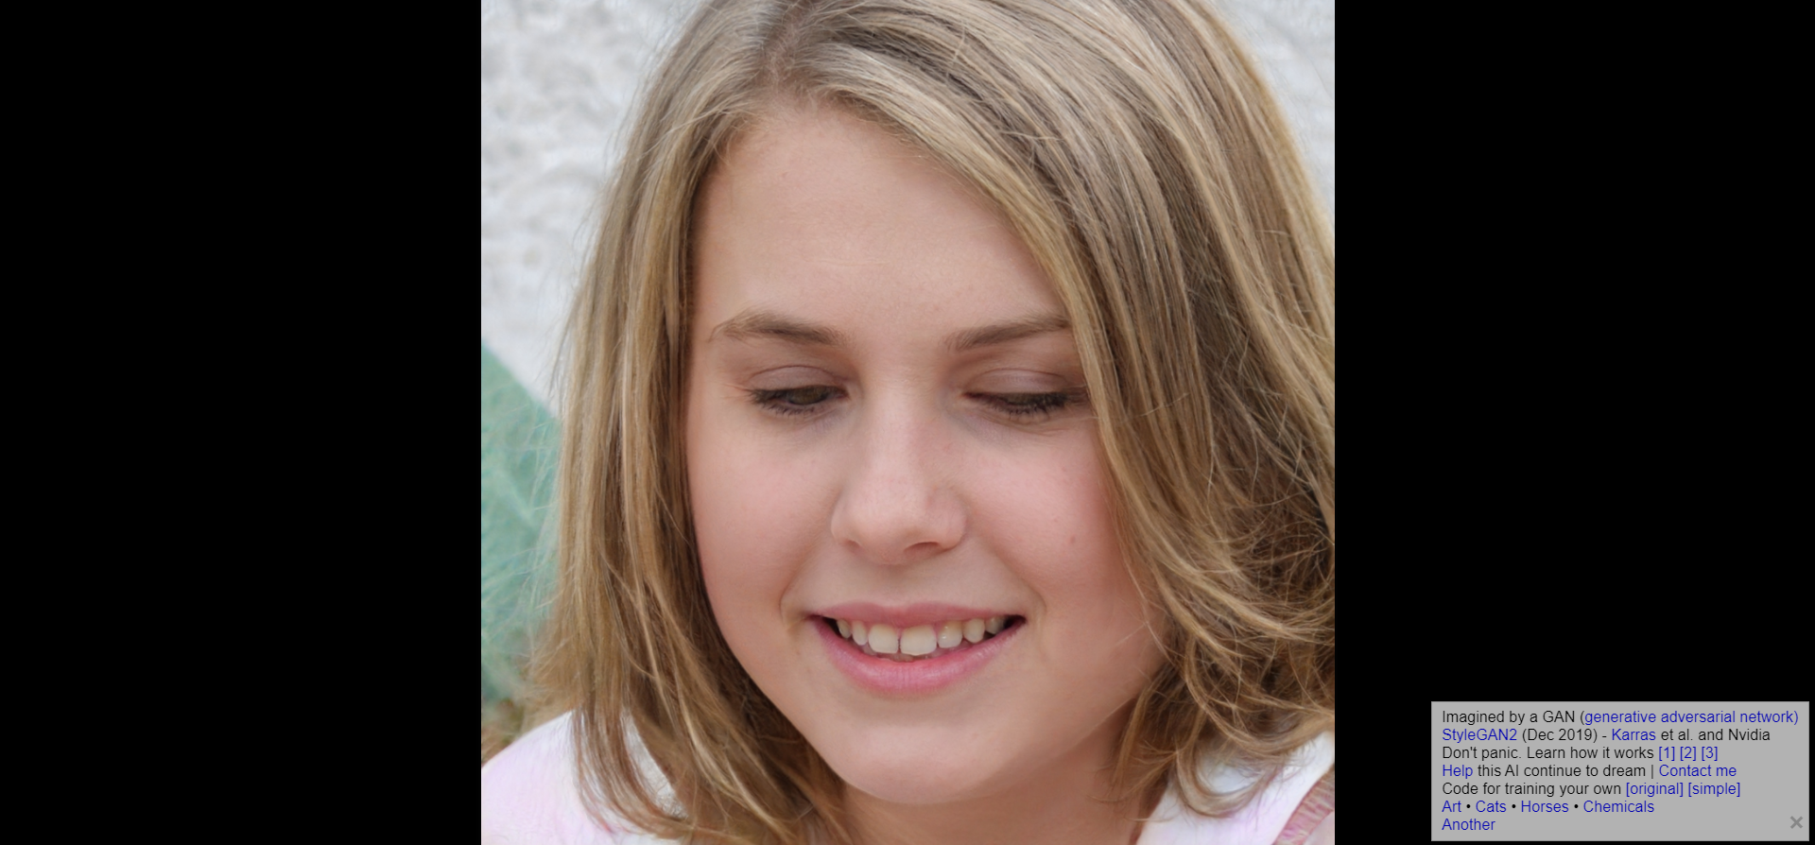
Trends : Imitation Learning, IRL (with GAN, GAIL)
https://thispersondoesnotexist.com/

Slide 19
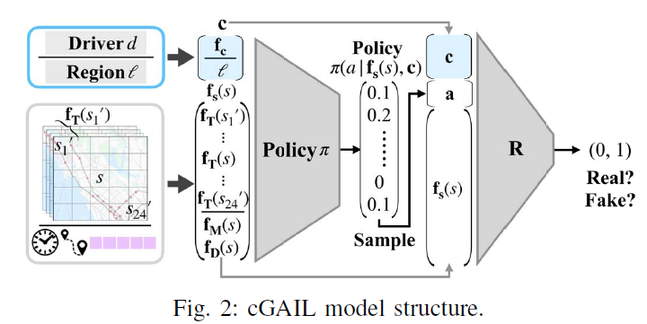
Trends : Imitation Learning, IRL (with GAN, GAIL)
ZHANG X, LI Y, ZHOU X, 2019. Unveiling taxi drivers’ strategies via cGAIL: Conditional generative adversarial imitation learning[J]. Proceedings - IEEE International Conference on Data Mining, ICDM, 2019-Novem(Icdm): 1480–1485. DOI:10.1109/ICDM.2019.00194.
Using cGAN + IRL (cGAIL), understand taxi driver’s preference.

Slide 20
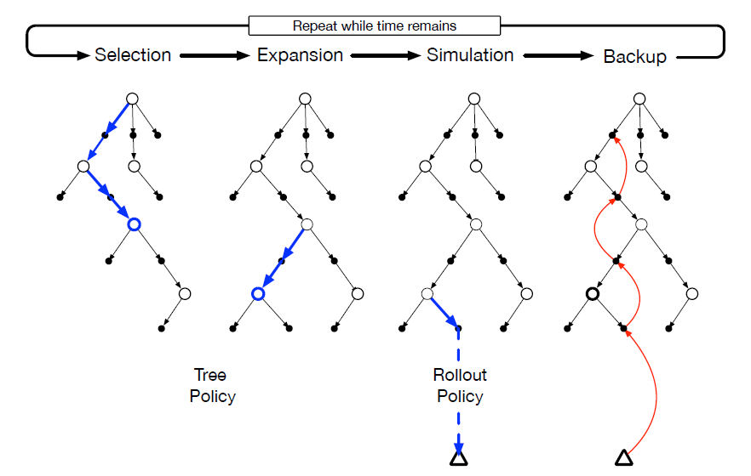
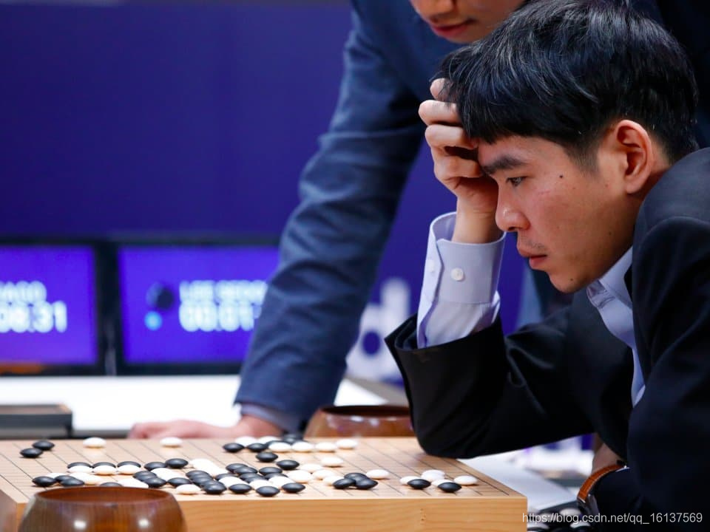
Trends : Model-based, Multi-Agent…
Model-based, most famous one is AlphaZero.
Core may be MCTS. I implemented it (a simply version) at:
https://github.com/PiperLiu/Approachable-Reinforcement-Learning/tree/master/AlphaZero

Slide 21
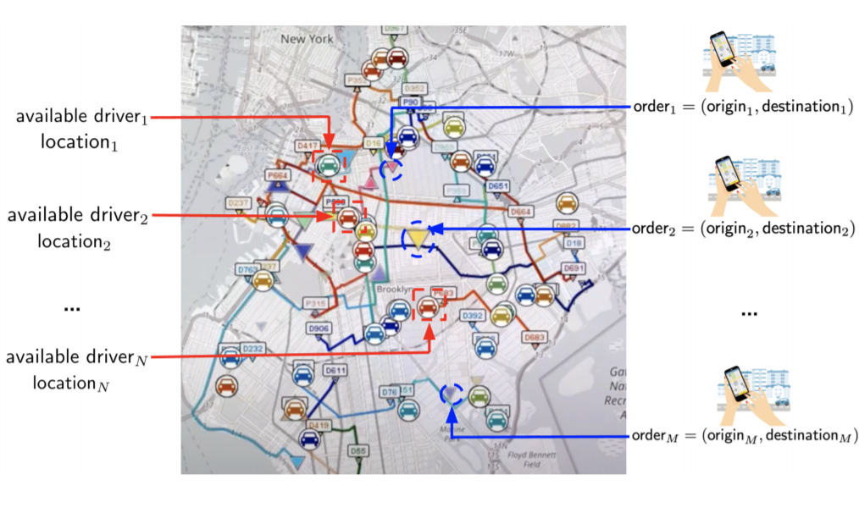
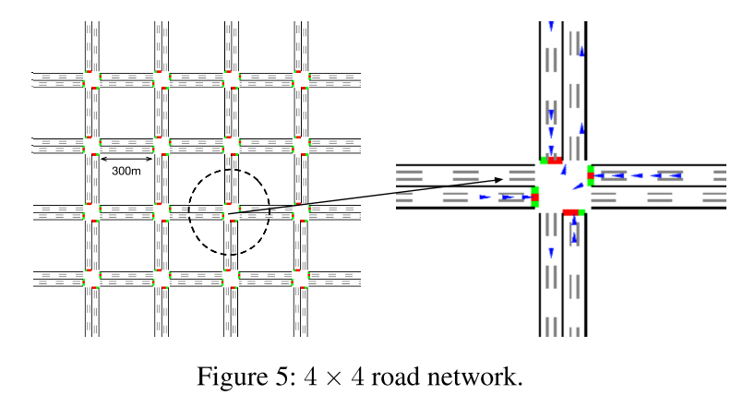
Trends : Model-based, Multi-Agent…
Multi-Agent, the most complicated question in RL. It can be combined with many knowledge like Game Theory, Mean Field…
How to let agents know to be cooperative?
Information sharing or not?
…

Slide 22
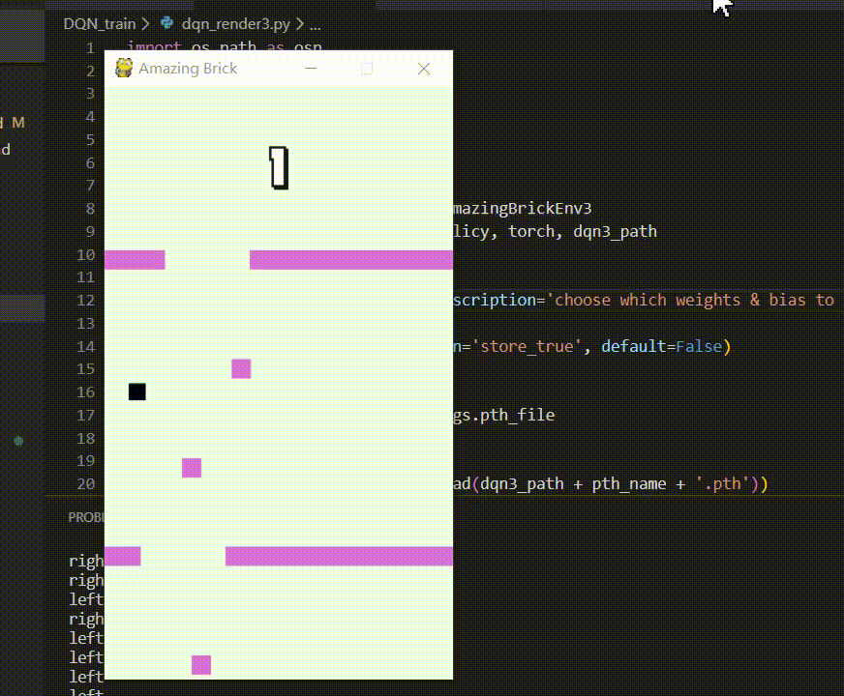
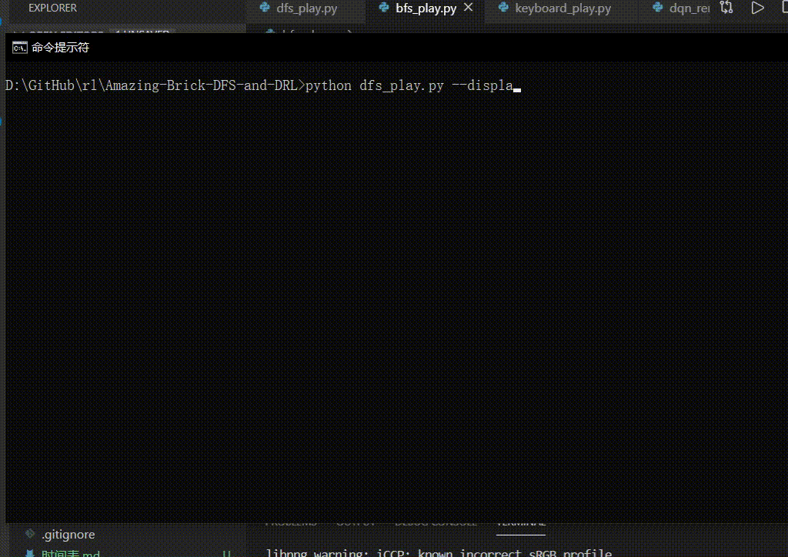
Personal Ideas : Good Resources I Found
My study routine (since 2019.12) :
Reinforcement Learning: An Introduction (2018), by Sutton, R.S. and Barto, A.G
Bolei Zhou’s video lectures (2020): https://space.bilibili.com/511221970/channel/detail?cid=105354
RL China’s video lectures (2020): https://space.bilibili.com/604515161/channel/detail?cid=143636
Some papers… (Mainly on scheduling and traffic…)
My practice:
KDD Cup 2020, RL Track, finalist, top 25 / 1050
Using traditional DFS and DRL to control game agents: https://github.com/PiperLiu/Amazing-Brick-DFS-and-DRL
Codes with big value:
https://github.com/ShangtongZhang/reinforcement-learning-an-introduction
gym: https://github.com/openai/gym
tianshou: https://github.com/thu-ml/tianshou
My ideas:
What about IRL to learn a solution of full-information
solution, but in a Dynamic Env?
What about GAIL for Abnormal Behavior (abnormal trace)?
Anything about decision making, may be able to try RL/IRL.

Slide 23
Thank you!
Piper Liu
piperliu@qq.com
https://github.com/PiperLiu
https://blog.csdn.net/weixin_42815609

